Slide 1
An Introduction to
the Bahá’í Faith
Part 1 – A Brief Overview

Slide 2
Who are the Bahá’ís?

Slide 3
Bahá’ís follow Bahá’u’lláh, whose name means “Glory of God”
Bahá’u’lláh said that He was the Promised One of all religions
Bahá’u’lláh said that He came to unite the world

Slide 4
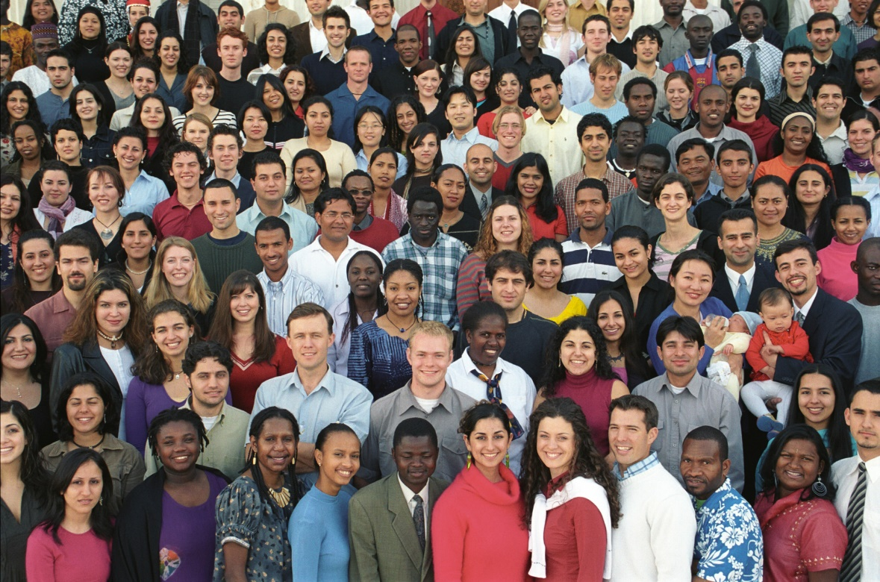
There are Bahá’ís in every country
in the world

Slide 5
What do Bahá’ís believe?

Slide 6
Bahá’ís believe in:
One God
One Religion
One People

Slide 7
One God
Bahá’ís believe that there is only one God, though we may call Him by different names.
God created everything we know, including us, so it is impossible for us to properly understand God. Is it possible for a painting to understand the painter who created it?

Slide 8
Abraham
Moses
Jesus
Muhammad
One Religion
Each religion is like a chapter
in a book, where each chapter
tells us more than we knew
before.
Each religion is perfect for its
time and place but each
Holy Teacher promises that
another one will come
afterwards.
Krishna
Buddha
Zoroaster
Bahá’u’lláh

Slide 9
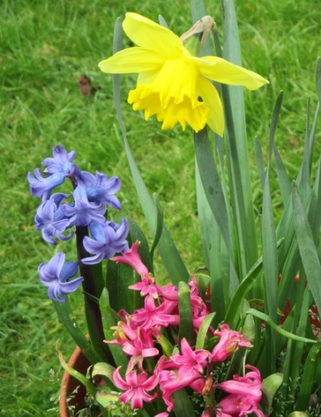
One People
Every person matters
Everyone should be treated equally
All people should be like one family
Bahá’u’lláh said that the people of the world are like the different flowers in a garden.
It is the differences which make the garden beautiful.

Slide 10
Community Life

Slide 11
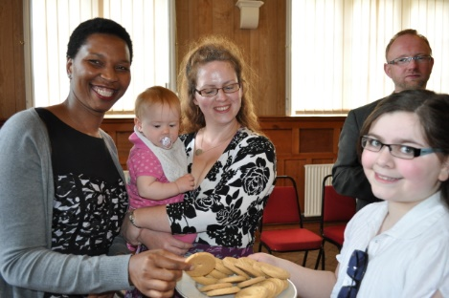
The regular meeting of each Bahá’í community is called a “Feast”.
Prayers are followed by community discussion.
The Feast ends with refreshments and friendship.

Slide 12
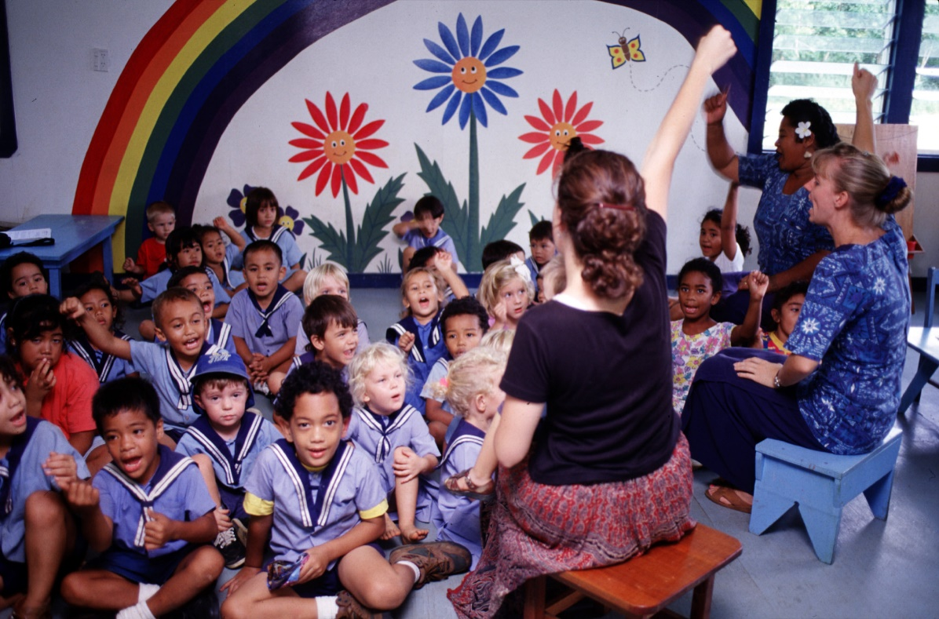
The children are a very precious part of any community.
Bahá’í classes for young children teach virtues such as kindness, generosity and unselfishness. Older children learn about Bahá’í history and teachings.
In all these classes, children learn how to be happy and helpful
to others.

Slide 13
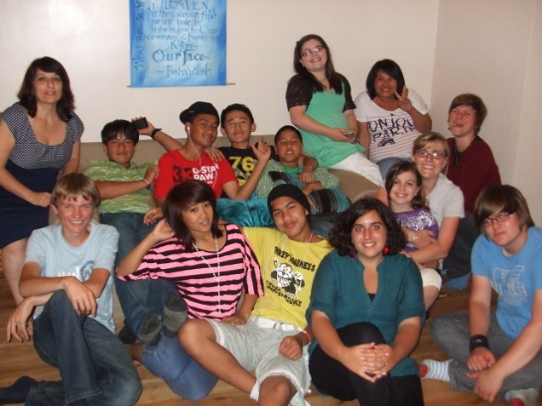
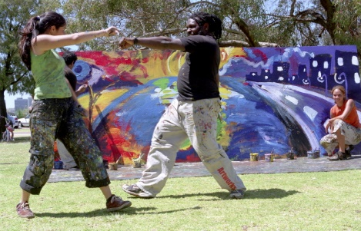
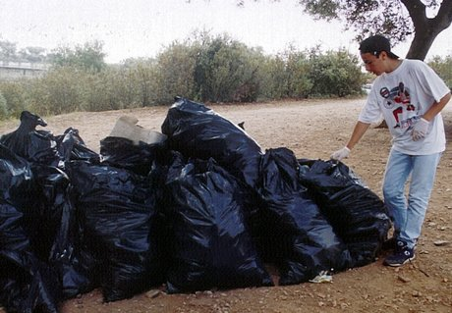
Young people from 11 to 15 are known as “junior youth”. They have their own courses and activities, particularly suited to their age group, where they learn to think positively about themselves and how they can contribute to the world.
They start by helping their local community in all kinds of ways – whatever needs to be done.

Slide 14
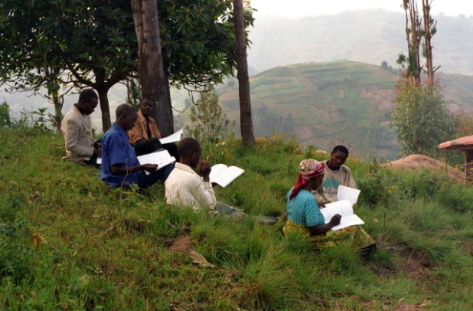
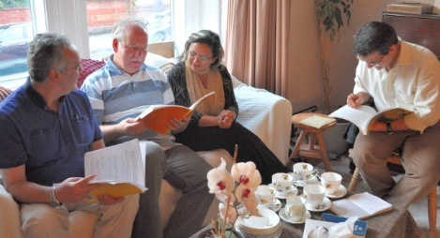
For people over the age of 15 there are study circles where they discuss Bahá’í beliefs, explore how to lead a spiritual life, and learn how to organise children’s classes and junior youth groups.
Many people who are not Bahá’ís enjoy these courses, where everyone’s opinion is valued.
Bahá’í activities are not just for Bahá’ís, they are for everyone.

Slide 15
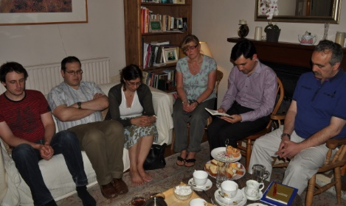
Each community has regular devotional meetings where everyone is welcome to share and enjoy the prayers, readings and music.
In a few places in the world there are large Houses of Worship which are open to everyone, whatever their religion.

Slide 16
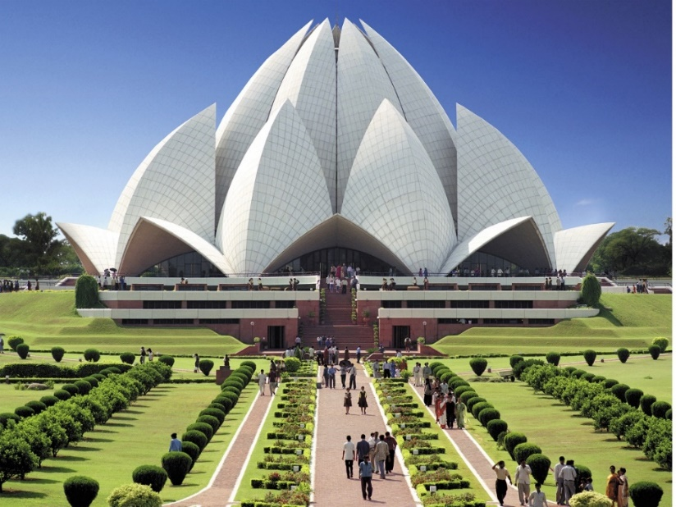
This House of Worship is near Frankfurt in Germany. It is the only one in Europe.
This House of Worship in India is designed to look like a giant lotus flower.
It is often known as the
“Lotus Temple”.

Slide 17
In each local area Bahá’ís elect an assembly of nine people who look after the welfare of the community. Each country has a national assembly and there is also a world body.

Slide 18
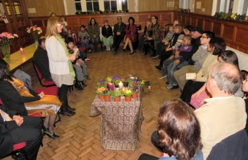
Bahá’ís work to promote the equality of men and women, and also to protect the rights of minorities. Bahá’í teachings say that men and women are like the two wings of a bird.
Both wings need to be equally strong for the bird to fly successfully.

Slide 19
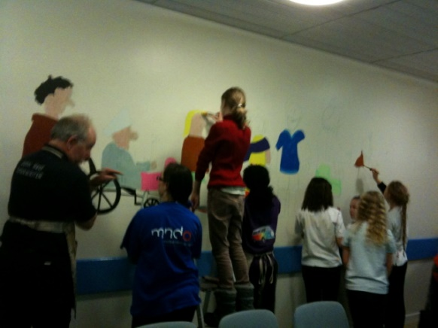
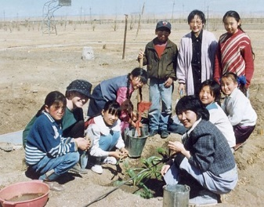
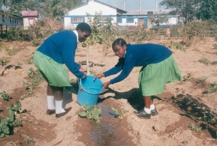
Wherever Bahá’ís live, they try to help improve the local community and bring people together. These are some pictures of community projects.

Slide 20
How did the
Bahá’í Faith begin?

Slide 21
In 1844, a young man called the Báb (meaning Gate) declared in Iran that a new world religion was coming.
___________________________________________________
His movement was violently persecuted, and He was shot by an entire regiment of soldiers in 1850.

Slide 22
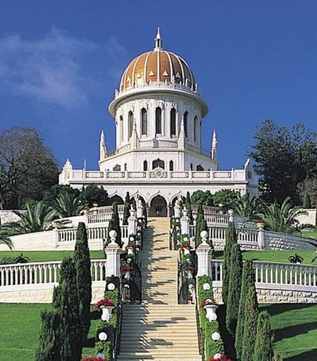
The Báb’s remains were hidden by His followers for nearly sixty years, and are now buried in this Shrine in the Holy Land.

Slide 23
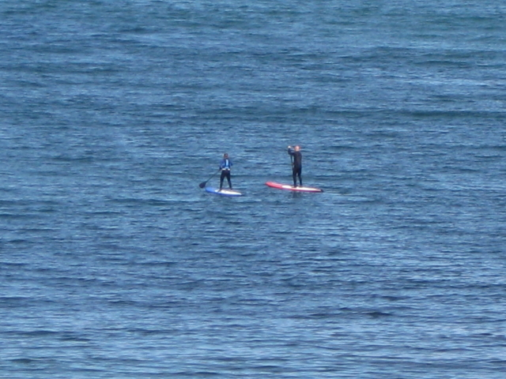
After the Báb
was killed,
Bahá’u’lláh announced that He was the new Messenger of God
bringing
a new religion for the whole world.

Slide 24
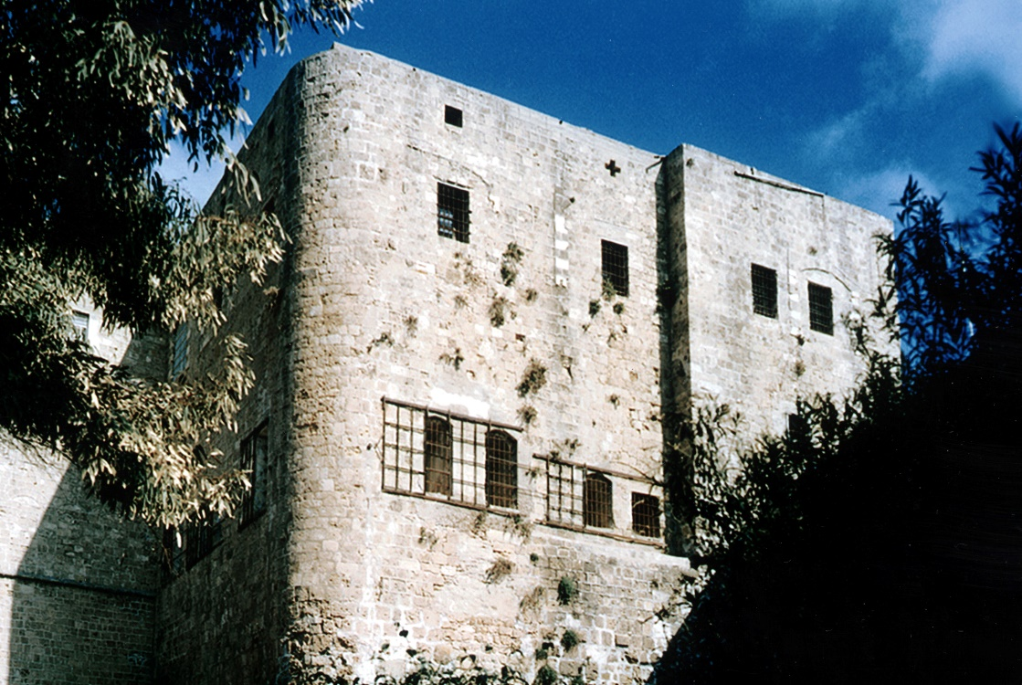
The rulers and religious leaders tried to destroy this new religion.
Bahá’u’lláh was tortured twice, imprisoned three times and exiled four times, but His Message continued to spread.
One of the prisons

Slide 25
Bahá’u’lláh passed away, far from home, at the age of 75. This is the entrance to His Shrine, which is near Akká, in the Holy Land.

Slide 26
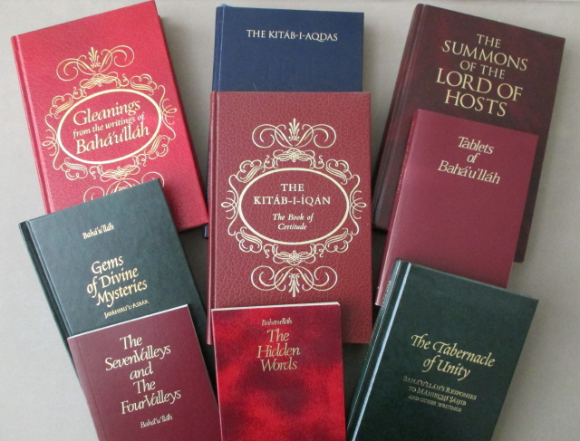
Bahá’u’lláh wrote a large number of books and letters. Here are a few of them:

Slide 27
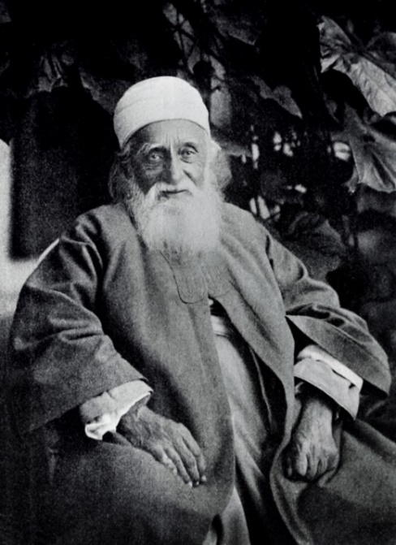
Because the Bahá’í Faith is a religion of unity, it was important to make sure that it did not split into sects. Bahá’u’lláh asked all the Bahá’ís to follow His Son, ‘Abdu’l-Baha, who had shared his Father’s life of exile and suffering. His name means “Servant of Bahá”, and this is the name he chose for himself.
‘Abdu’l-Baha became a free man late in life and was able to visit Britain, Europe and America to tell people about the Bahá’í Faith.

Slide 28
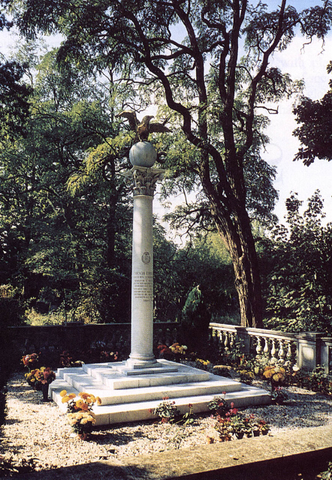
‘Abdu’l-Baha appointed his grandson, Shoghi Effendi, to be the Guardian of the Bahá’í Faith after his death. The Guardian translated many of Bahá’u’lláh’s books into English and he helped the Bahá’ís to spread worldwide.
He was visiting London when he died in 1957 and is buried there.

Slide 29
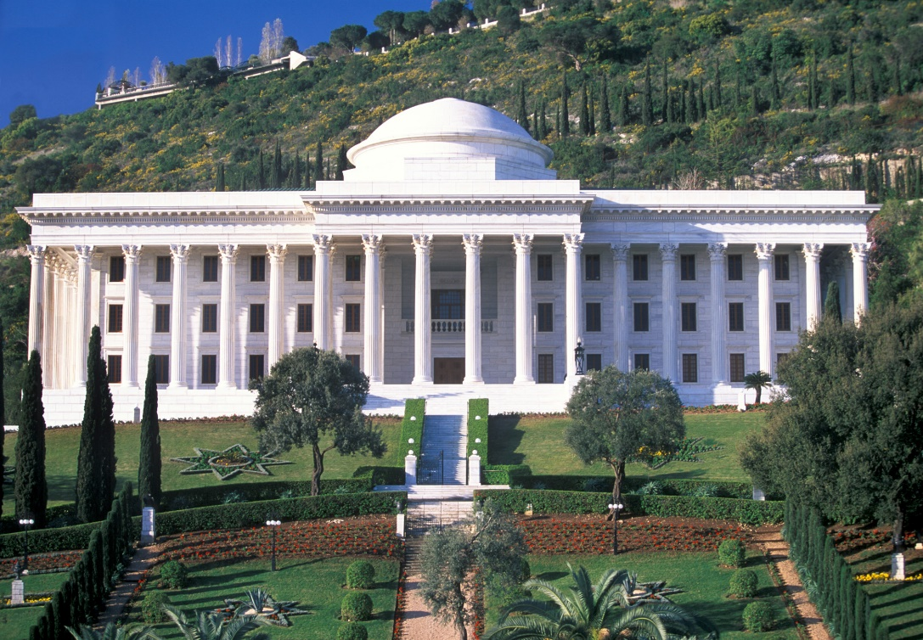
Bahá’u’lláh said that a world body should be set up called the Universal House of Justice. This was first elected in 1963. It is based in Haifa, in the Holy Land, and is elected every 5 years.

Slide 30
Bahá’í Teachings for the World

Slide 31
Bahá’u’lláh said that there should be:
A world peace conference
where the countries should agree on their boundaries and limit the number of weapons each country can hold
A world government
so that we can have a system of world law and justice and will be able to protect the ecology of the planet
A world language
so that we can all understand one another better

Slide 32
Bahá’u’lláh also said that there should be a fairer economic system so that there will no longer be huge differences between rich and poor countries, or rich and poor people.
There should be:
A world currency
A world system of weights and measures
A minimum wage
Workers sharing in the profits of their company
A limit to wealth

Slide 33
This has been a very brief introduction
to the Bahá’í Faith.
For more information see Part 2 – Laws and Practices
See also
www.bahai.org
Produced by P&A Vickers for the UK Bahá’í RE agency. Most photographs courtesy of the Bahá’í Media Bank.

