Slide 1
Evidence gathering for the
Commission on Religious Education
23 February 2017
Jenny Lockwood and Lindsay Thorne
on behalf of the UK Bahá’í Community

Slide 2
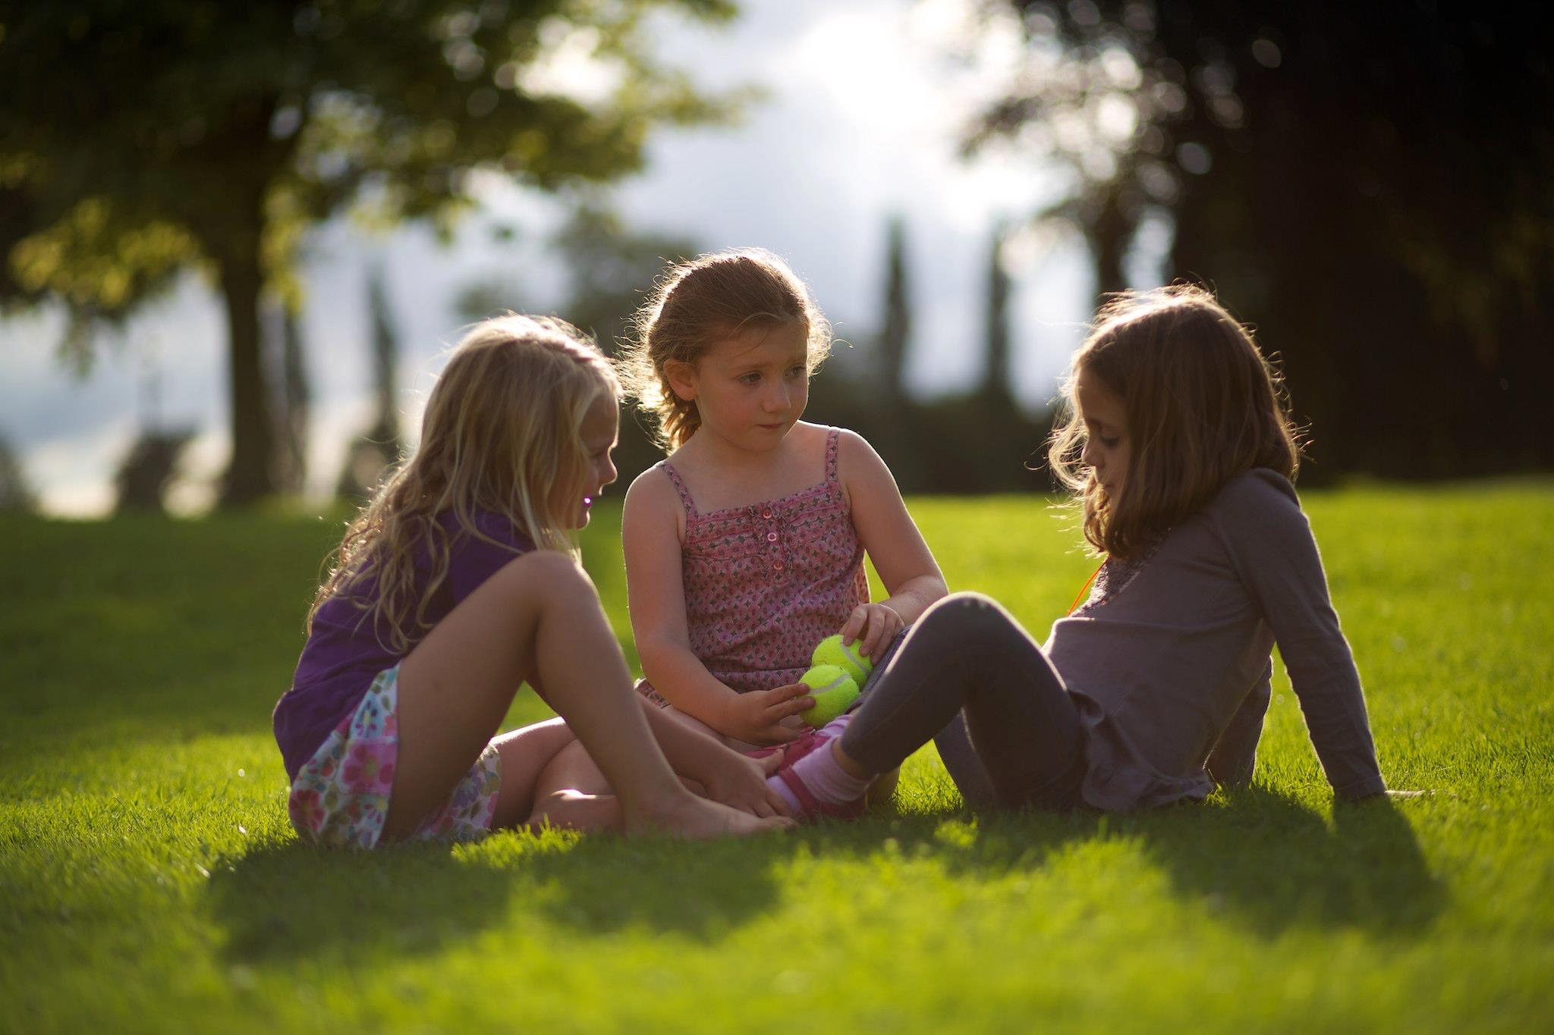
The purpose of RE
“Every child is potentially the light of the world.” ‘Abdu’l-Bahá

Slide 3
The purpose of RE
Personal spiritual and ethical development
Essential values shared across different faiths
The historical and social context of how and when faiths emerged and developed
Understanding why people hold certain beliefs or practices, and how they put these beliefs and practices into action

Slide 4
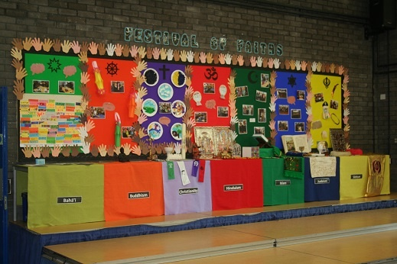
RE in a changing world
“The real treasury of man is his knowledge…” Bahá’u’lláh
Goytre Fawr Primary School, Penperlleni
Festival of Faiths - March 2016

Slide 5
RE in a changing world
Importance of RE to social cohesion
Religious literacy: if you don’t understand faith, you can’t understand history
Understanding what faith means in people’s lives, in diverse communities
Making sense of the state of the world

Slide 6
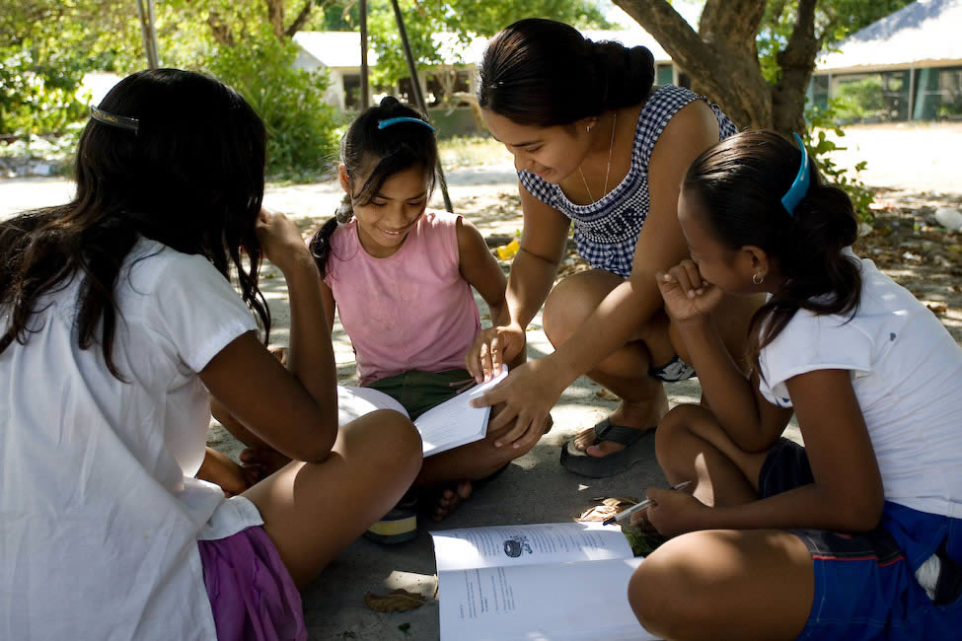
Why are SACREs important?
“Consort with the followers of all religions in a spirit of friendliness and fellowship” Bahá’u’lláh

Slide 7
Why are SACREs important?
Local support for RE provision in schools is vital – even with a national curriculum
Consultation network across SACREs
Children need to learn about a range of faiths regardless of diversity in the local community
e.g. Worcestershire, Gloucestershire, Herefordshire SACREs – range of faiths represented and involved in ASC although not a diverse population

Slide 8
Annotations to the slides (1): Introduction
Jenny and Lindsay introduced themselves as members of the RE Task Force of the UK national Bahá'í community. Its work involves:
making available good quality resources on the Bahá'í Faith for teachers
helping schools to find speakers and visitors from within their local Bahá'í community
supporting Bahá'í representatives on some 80 SACREs around the country (we are ourselves both members of SACREs)
presenting a Bahá'í perspective in national forums such as the RE Council and our input to this RE Commission
Three areas of focus in our short presentation:
1) The purpose of RE
2) RE in a changing world
3) Why are SACREs important?

Slide 9
Annotations to the slides (2): The purpose of RE
The Bahá’í Faith stresses the basic spiritual nature of human existence, and the importance of developing the spiritual qualities innate in every child.
This takes place throughout life, starting at the earliest stage in our education.
Children and young people need knowledge and an understanding of a range of faiths and beliefs.
Through this they should learn that many essential values are shared across different faiths. It is important for children to learn about the similarities across faiths and not just the things that make them different, which are often more related to practices than core values.
In answer to a question, this was re-asserted as an essential part of the purpose of RE.
Importance of learning about sources of authority and how these are interpreted by different faiths.

Slide 10
Annotations to the slides (3): RE in a changing world
RE should be taught in all schools (including Faith schools) and provide a common baseline of knowledge of a range of faiths and beliefs.
RE is important to social cohesion. Lindsay extended Jenny’s earlier point about recognising commonality between faiths, to emphasise how RE can encourage social cohesion. It enables students not only to find agreement, but also, through the study of RE, they can acquire a historical perspective of the relationship of religions and great cultures.
In order to encourage a balanced view, the opportunity for pupils to examine sources of faith and spirituality was essential in order to gain an insight into how to make sense of the world.
People will not necessarily live out their lives in the community they grew up in. Even if they do, that community may change significantly in its cultural and ethnic diversity, as well as in the beliefs held by members of that community. Understanding faiths is as critical in non-diverse communities as it is in those with a diverse population – possibly more important. Also many communities are subject to population movements, such as experienced in recent years in various parts of the UK.
Very importantly, an understanding of spirituality, and knowledge about faith, can help young people to make sense of a world which is very often depressing and frightening.

Slide 11
Annotations to the slides (4): Why are SACREs important?
The issues related to SACRE were modified because some points had already been mentioned by previous speakers.
Lindsay referred to the active support of the Bahá’ís for SACREs (80+ SACREs having a Bahá’í rep).
The continuing advice and support offered by the RE Task Force to these Bahá’í reps indicates how seriously we consider the importance of local consultation, not only for Bahá’ís but for all faiths
SACREs provide a sounding board in which to develop coherent support for all those involved in education. The importance then of a local body to support provision in schools is vital even with a national curriculum.
In answer to questions, the difficulties of some SACREs regarding finance and educational support was cited. The collaboration and pooling of resources between counties(e.g. Worcestershire, Gloucestershire and Herefordshire) illustrates the level of commitment, goodwill and determination that exists, along with the support of our educational provider (RE Today) and the many voluntary members.

